Slide 1

BH INFRA AI CHALLENGE
BH Evidence
Lens
From assumption to
data backed decision
A human-led AI agent that builds assumptions using BH knowledge, present-site evidence and future scenarios.
THE AGENT STRENGTHENS THE EVIDENCE.
THE CONSULTANT DECIDES.
-Netal Chandak
Notes:
[Sources]
Internal source: BH_Evidence_Lens_Final_Live_Case_Studies_NORA_RUA (1).pptx.
Visual on this slide was generated with Microsoft Copilot.
[/Sources]

Slide 2

01 | WHY NOW
AI should improve the decision, not only accelerate the task.
Speed is useful. The strategic opportunity is to challenge the assumptions embedded in the existing process.
FASTER VIEW
BETTER VIEW
Search faster
Draft faster
Summarise faster
Produce faster
Expose assumptions
Test comparability
Find evidence gaps
Explore alternate futures
Useful
Transformative
MAKE ASSUMPTIONS VISIBLE, TESTABLE AND CHALLENGEABLE.
Notes:
[Sources]
Internal source: BH_Evidence_Lens_Final_Live_Case_Studies_NORA_RUA (1).pptx.
Visual on this slide was generated with Microsoft Copilot.
[/Sources]

Slide 3
02 | THE CHALLENGE
Every project is built on assumptions.
But too often, the evidence behind them is fragmented, hidden or difficult to challenge.
Programme & phasing
Personal experience
Site evidence
THE PROJECT QUESTION
How much capacity will this district need?
Past project reports
Manual External research
Client targets
THE PROBLEM IS NOT THAT ASSUMPTIONS EXIST. IT IS THAT THEIR EVIDENCE TRAIL IS NOT REPEATABLE.
When an assumption cannot be traced, it cannot be properly challenged.
Notes:
[Sources]
Internal source: BH_Evidence_Lens_Final_Live_Case_Studies_NORA_RUA (1).pptx.
[/Sources]

Slide 4
03 | THE INSIGHT
Same project question. Different consultant. Different assumption.
Professional diversity is valuable. Hidden, unstructured differences are the risk.
TRANSPORT
URBAN STRATEGY
INFRASTRUCTURE
CLIMATE + RESILIENCE
BUILDINGS + PLACES
Network capacity
Mode share
Parking
Density
Activation
land use
Delivery
Readiness
Resilience
Future baselines
Heat
Risk
Occupancy
Energy
Servicing
BH EVIDENCE LENS • SHARED EVIDENCE BASE
Make every material difference explicit, evidence-backed and visible.
THE AIM IS NOT TO MAKE EVERY CONSULTANT THINK THE SAME WAY. IT IS TO MAKE THE BASIS OF JUDGMENT TRANSPARENT.
Notes:
[Sources]
Internal source: BH_Evidence_Lens_Final_Live_Case_Studies_NORA_RUA (1).pptx.
[/Sources]

Slide 5
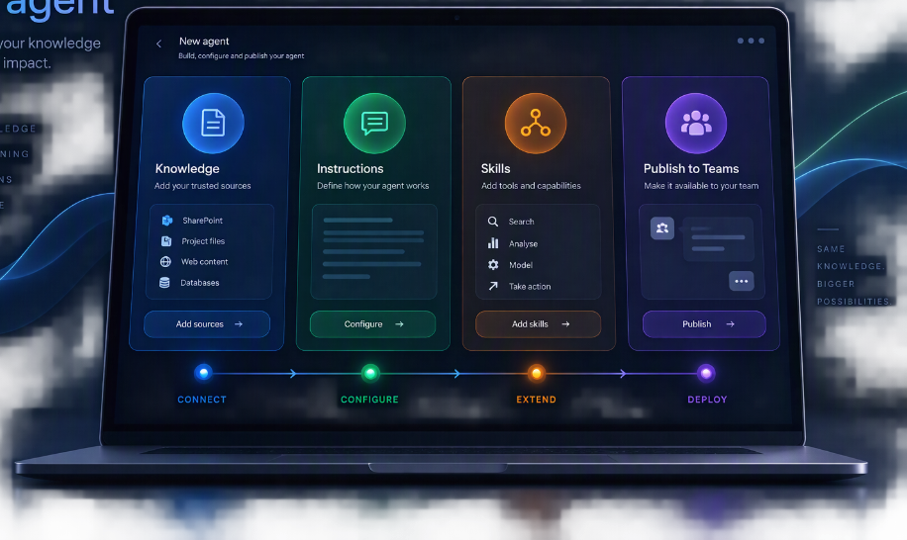
04 | INTRODUCING THE AGENT
Build once. Configure with BH expertise. Use through Teams.
A lightweight Copilot Studio setup turns trusted BH knowledge and repeatable specialist methods into a shared consultant assistant.
Publish on Teams as a chat bot
Notes:
[Sources]
Internal source: BH_Evidence_Lens_Final_Live_Case_Studies_NORA_RUA (1).pptx.
[/Sources]

Slide 6
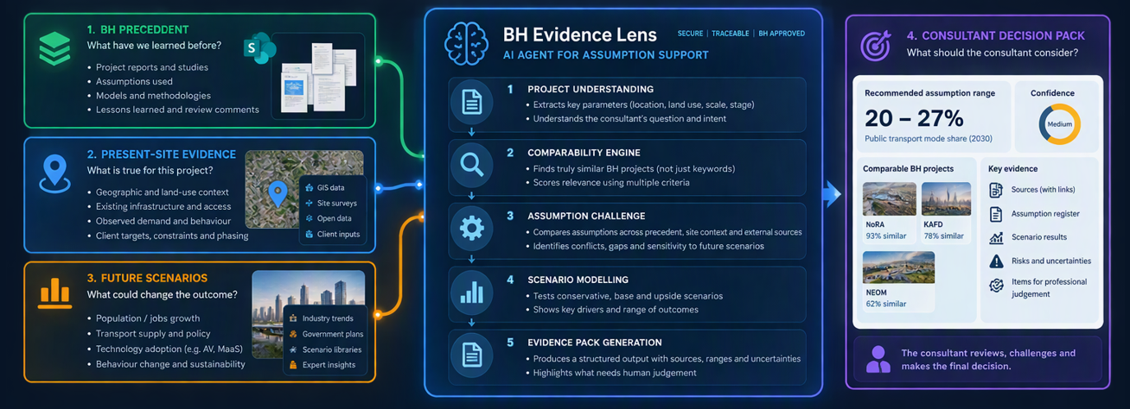
05 | HOW THE AGENT WORKS
Publish on Teams as a chat bot
Notes:
[Sources]
Internal source: BH_Evidence_Lens_Final_Live_Case_Studies_NORA_RUA (1).pptx.
[/Sources]

Slide 7
06 | AGENT VS. GENERAL AI
The differentiator is the workflow, not the base model.
The same underlying intelligence can produce very different assumption value when knowledge, controls and validation are configured.
USER-LED
WORK-GROUNDED
TASK-CONFIGURED
BH DIFFERENTIATOR
GENERAL COPILOT
M365 COPILOT
COPILOT AGENT
BH EVIDENCE LENS
Flexible conversation
Work-grounded assistance
Configured repeatable task
Purpose-built decision workflow
Context supplied each time
Grounds in accessible M365 data
Selected knowledge sources
Approved BH sources + access controls
Web/tools when enabled
Uses tenant permissions
Specific project context
Reusable retrieval layer + project taxonomy
Sources depend on use
References implementation varies
Explicit instructions and tools
External research as a governed step
Source + date + assumption required
Scenarios prompted manually
Can support prompts and workflows
Evidence outputs can be designed
Standard drivers + sensitivity ranges
Repeatability requires setup
Broad productivity experience
Repeatable process by design
Fixed workflow + validation gates
BH DIFFERENCE = INTERNAL PRECEDENT + EXTERNAL EVIDENCE + SCENARIO LOGIC + VALIDATION GATES
Notes:
[Sources]
Internal source: BH_Evidence_Lens_Final_Live_Case_Studies_NORA_RUA (1).pptx.
[/Sources]

Slide 8

07 | REAL PROJECT VALIDATION
NoRA: from a target
to a defensible decision.
The agent does not invent the target. It reconstructs the evidence path and tests what must be true.
WHAT THE EVIDENCE LENS DID
01
RETRIEVED
150 cities → 11 relevant comparators
REAL INPUT • NoRA MOBILITY STRATEGY
02
SEPARATED
External PT share vs internal sustainable share
40%+
PUBLIC TRANSPORT
03
TESTED
Transit supply, density, access, parking and phasing
50%+
SUSTAINABLE INTERNAL TRIPS
04
EXPOSED
What is approved, modelled and still missing
70%+
TRIPS INTERNALISED
05
PACKAGED
Range + sensitivity + source trail + review gate
STATUS • PROJECT KPIs. IMPLICATIONS STILL REQUIRE TESTING.
RESULT • Not a “magic number” - an auditable path from ambition to investment conditions.
8
Notes:
[Sources]
- <File>20260724_NoRA Urban framework July BoD section_v5.pptx</File>: 40%+ PT, 50%+ sustainable internal trips, 70%+ internalised trips; KPIs to be tested.
- <File>NoRA_Mode_Share_Past_Work_Recap.pptx</File>: 150 cities benchmarked, 11 shortlisted, 3 comparator groups.
- <File>NoRA_Mode_Share_Benchmark_Deck.pptx</File>: segment, test, localise, enable and monitor framework.
Visual on this slide was generated with Microsoft Copilot.
[/Sources]

Slide 9
08 | BUSINESS VALUE
Where the saving comes from: reuse the evidence, not the effort.
A transparent value model. Project facts are grounded; time and rate inputs below are editable pilot assumptions.
WITHOUT THE LENS
WITH THE LENS
EDITABLE PILOT VALUE MODEL
01
SEARCH
Find the right decks and versions
✓
REUSE
Approved retrieval layer
100
similar evidence questions / year
02
EXTRACT
Pull benchmarks and targets
✓
FILTER
Comparator taxonomy
6 h
illustrative net saving / question
03
RECONCILE
Resolve conflicting assumptions
✓
CALCULATE
Scenario driver template
600 h
consulting capacity released
04
REBUILD
Repeat charts and narrative
✓
TRACE
Source + date + assumption
× rate
apply BH loaded hourly rate
05
CHECK
Create source trail at the end
✓
REVIEW
Consultant approval gate
ANNUAL VALUE
600 × loaded hourly rate
AGENT RUN COST
Illustrative 100 users × 3 questions/day × 22 days: $132–$792/month, depending on grounding and actions.
VALUE GATE • Measure actual hours saved and credits consumed during pilot.
9
Notes:
[Sources]
- <File>NoRA_Mode_Share_Past_Work_Recap.pptx</File>: evidence base of 150 cities and 11 shortlisted comparators demonstrates a reusable research asset.
- Microsoft Learn, Billing rates and management: 2 credits for a generative answer, 5 for an agent action, 10 for tenant graph grounding; accessed 28 September 2026.
- Microsoft Copilot Studio Plans and Pricing: PAYG and prepaid options; accessed 28 September 2026.
- The 100 questions/year, 6 hours/question and loaded hourly rate are editable pilot assumptions, not measured results.
[/Sources]

Slide 10
10 | TIME SAVED
One shared agent turns small daily searches into major capacity.
Illustrative adoption model: 100 employees × 3 questions/day × 22 working days. Replace the 10-minute assumption after the pilot.
100
×
3
×
22
×
6,600
EMPLOYEES
QUESTIONS / DAY
WORKING DAYS
QUESTIONS / MONTH
10 min
1,100 HOURS / MONTH
saved per question
13,200 HOURS / YEAR
Search, locate, open, scan and re-explain
consulting capacity potentially released
NoRA-type complex evidence request: manual 6–12 h → agent-assisted 1–2 h → illustrative saving 5–10 h per request.
BH EVIDENCE LENS • BUSINESS VALUE
10
Notes:
[Sources]
- Internal source: <Event>BH AI Infra Strategy</Event>, 17 September 2026: the proposed shared Teams agent is intended to reduce search and recreation of existing work.
- Internal source: <Event>Training: A BH intro to AI (Session 01)</Event>, 9 September 2026: contextual search example reduced 15–20 minutes to approximately one minute.
- Assumptions for this slide: 100 employees, 3 questions/day, 22 working days and 10 minutes saved/question. These are illustrative and must be replaced with measured pilot data.
[/Sources]

Slide 11
11 | LICENCE COST SAVED
Everyone can use the published agent. Not everyone needs a $30 licence.
Comparison for 100 employees. The agent is centrally funded through Copilot Studio credits; full M365 Copilot remains optional for users who need Office-wide functionality.
BLANKET LICENSING
ONE SHARED STUDIO AGENT
100 × $30 × 12
100 users • 6,600 questions/month
$36,000 / YEAR
SIMPLE
+ ACTION
GRAPH + ANSWER
$1,584 / yr
$5,544 / yr
$9,504 / yr
Every employee receives full Microsoft 365 Copilot
$34,416 saved
$30,456 saved
$26,496 saved
96%
85%
74%
Useful only if all 100 users need Copilot across Word, Excel, Outlook, PowerPoint and Teams.
ANNUAL LICENCE SAVING
$26.5k–$34.4k
74%–96% lower than licensing all 100 users
BH EVIDENCE LENS • BUSINESS VALUE
11
Notes:
[Sources]
- Microsoft 365 Copilot enterprise pricing: $30 per user/month, paid yearly.
- Microsoft Learn, Copilot Studio billing rates: generative answer 2 credits; agent action 5 credits; tenant graph grounding 10 credits.
- Internal source: <Event>Training: A BH intro to AI (Session 01)</Event>, 9 September 2026: a mass-adoption agent deployed through Copilot Studio can be used beyond Microsoft 365 Copilot users and is funded through credits.
- Calculations assume PAYG at $0.01 per credit and 6,600 questions/month. Actual BH enterprise pricing, tax, fair-use terms and agent design must be verified before procurement.
[/Sources]

